Slide 1
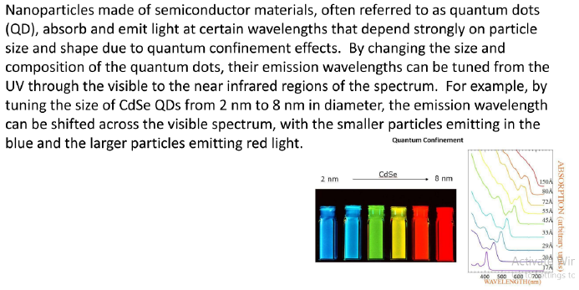
QUANTUM DOTS

Slide 2
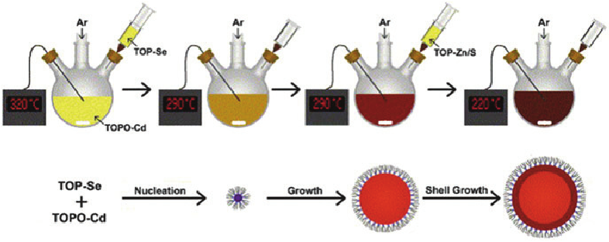
Colloidal Synthesis of Cdse Quantum Dots
A cadmium compound is heated to 320 ○C and dissolved in an organic solvent. At room temperature selenium compound dissolved in a different organic solvent is injected into the reaction vessel, causing supersaturation of the resultant CdSe solution. As the temperature drops to around 290○ C, nucleation of new crystals stops and existing crystals grow. After a period of growth, the length of which determines the size of the QDs, the solution is cooled to 220 ○ C, stopping growth. A small amount of zinc sulfide is injected into the reaction vessel to coat the QDs and prevent them from reacting with the environment

Slide 3
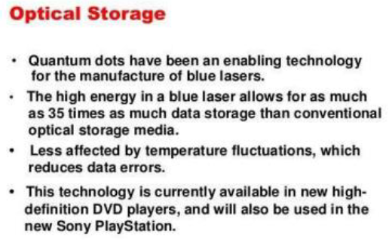
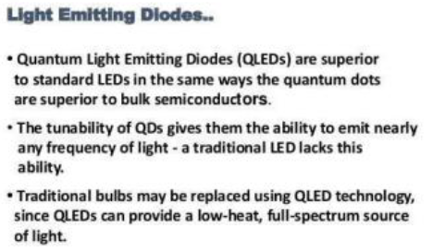
Applications in Electronic Gadgets

Slide 4
Types of Semiconductors
Semiconductors can be classified as:
Intrinsic semiconductor
Extrinsic semiconductor
Extrinsic semiconductor
Extrinsic semiconductor are further classified as;
n-type semiconductors
p-type semiconductors

Slide 5
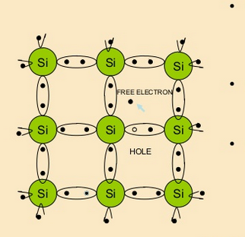
Intrinsic Semiconductors
An intrinsic semiconductor is a pure semiconductor.
The number of excited electrons and the number of holes are equal; n=p.
Example; Pure silicon (Si) and pure germanium (Ge).

Slide 6
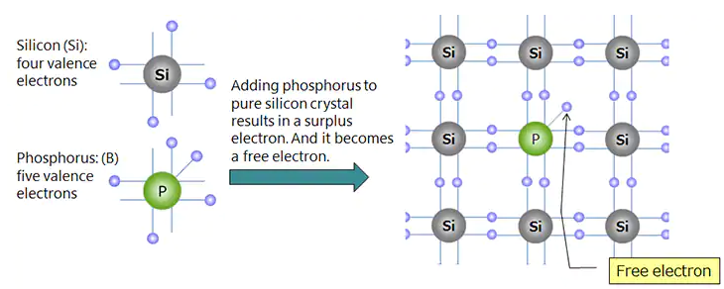
N-type Semiconductors
When a pentavalent impurity (Group-V) such as Phosphorous (P) or Arsenic (As) is added into pure silicon materials it formed n-type semiconductor.
P or As has 5 valence electrons. Four of them are utilized to form covalent bond with silicon as shown in Scheme.

Slide 7
N-type Semiconductors
Fifth electron is superfluous, becomes free electron (n for negative) and enters into the conduction band.
These free electrons eventually carry electrical current. Pentavalent impurity is known as donor.

Slide 8
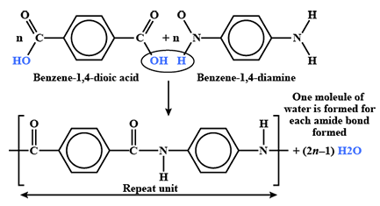
KEVLAR
Synthesis
Kevlar is a polyamide formed from 1,4-diaminobenzene and terephthalic acid

Slide 9
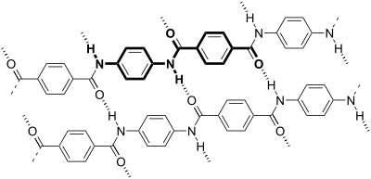
KEVLAR
Properties
Strength of Kevlar is mainly due to hydrogen bonding between N-H and C=O groups of two polymeric chains.
Kevlar fiber has a tensile strength of about 3,620 Mpa and relative density of 1.44 g/cc.
Kevlar maintains its strength and resilience down to cryogenic temperatures −196 °C

Slide 10
KEVLAR: Applications
Kevlar is often used in the field of cryogenics.
It is a well-known components such as combat helmets, ballistic face masks, and ballistic vests.
It is used to prepare gloves, sleeves, jackets, and chaps
Kevlar is widely used as a protective outer sheath for optical fiber cable, as its strength protects the cable from damage and kinking.
It is a fibre used for making bullet proof vests.
Some cell phones have a Kevlar back plate.
Kevlar 149 is used in aircraft construction.
The wing leading edge is one application, Kevlar being less prone than carbon or glass fiber to break in bird collisions.

Slide 11
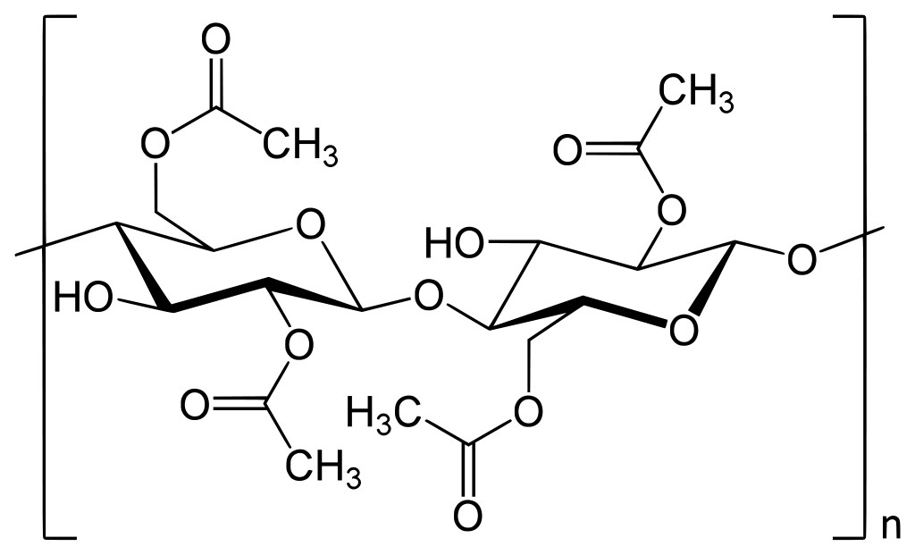
Cellulose Acetate
Cellulose acetate is an acetate ester of cellulose, generally cellulose diacetate.
It is a bioplastic and is used as a film base in photography, as a component in some coatings, and as a frame material for eyeglasses.
It is also used as a synthetic fiber in the manufacture of cigarette filters and playing cards.
In photographic film, cellulose acetate film replaced nitrate film because it is less flammable and cheaper.

Slide 12
Preparation:
Acetylating the cellulose: The commercial production of cellulose acetates follows; 1. acetic acid process or 2. methylene chloride process
1. Acetic acid processes: the pre-treated cellulose is reacted in acetic acid (solvent) with an excess of acetic anhydride, and with sulphuric acid as a catalyst.
The reaction is highly exothermic and therefore intensive cooling of the reaction vessels is required.
The esterification process is quenched by adding of water.
This solution must be gel-free and have the desired viscosity.

Slide 13
2. Methylene chloride process :
Methylene chloride is used in the acetylation mixture as a solvent instead of acetic acid.
Since, low-boiling methylene chloride can be easily removed by distillation.
Methylene chloride at low temperatures can dissolve cellulose triacetate very well.
A small amount of sulfuric acid can used as a catalyst, but most often perchloric acid is used.
However, acetic acid is usually also formed as a by-product of the reaction.
A very rare heterogeneous process is the fiber acetate process, which is only used for the production of cellulose triacetate as an end product.
In this process, the cellulose is suspended in benzene and esterified with acetic anhydride in the presence of perchloric acid as catalyst.

Slide 14
Applications:
Applications:
Cellulose acetate is used as a film base materials in photography.
It is use as a component in some adhesives.
It is used as frame material for eyeglasses.
it is also used as a synthetic fiber and in the manufacture of cigarette filters, found in screwdriver handles, ink pen reservoirs, x-ray films.

Slide 15
Composition, properties and applications of duralumin
What is Duralumin?
Duralumin is a strong, lightweight alloy of aluminium discovered in 1910 by Alfred Wilm, a German metallurgist.
Chemical Composition
Aluminum, Al | 95
Copper, Cu | 4
Magnesium, Mg | 1
Properties:
It is relatively soft, ductile and easily workable under normal temperature.
The alloy can be rolled, forged and extruded into various forms and shapes of products.
The tensile strength of duralumin is higher than aluminum.
The electrical and heat conductivity of duralumin is less than that of pure aluminum and more than that of steel.

Slide 16
Composition, properties and applications of duralumin
Applications
Aircraft frames.
Frames of speedboats and automobiles.
Lightweight guns like the FAMAS type 97.
Surgical and orthopedic work.
Manufacturing components of measuring instruments.

Slide 17
Carbon Steel: Composition, Properties and Applications
What Carbon Steel?
Carbon steel is a common type of steel that is an alloy of iron and carbon.
It has a higher carbon content, lower melting point and greater durability compared to stainless steel.
Carbon steel is the most widely used engineering and construction material for industrial applications on a large scale, including marine structures, power plants, transportation, chemical processing and petroleum production and refining.

Slide 18
Carbon Steel: Composition, Properties and Applications
Types of carbon steel and their properties
 | Carbon content (wt.%) | Microstructure | Properties | Examples
Low-carbon steel | < 0.25 | Ferrite, pearlite | Low hardness and cost. High ductility, toughness, machinability and weldability | AISI 304, ASTM A815, AISI 316L
Medium-carbon steel | 0.25 – 0.60 | Martensite | Low hardenability, medium strength, ductility and toughness | AISI 409, ASTM A29, SCM435
High-carbon steel | 0.60 – 1.25 | Pearlite | High hardness, strength, low ductility | AISI 440C, EN 10088-3

Slide 19
Carbon Steel: Composition, Properties and Applications
Applications of Different Carbon Steel.
1. Low-carbon steel
Low carbon steels are often used in automobile body components, structural shapes (I-beams, channel and angle iron), pipes, construction and bridge components, and food cans.
2. Medium-carbon steel
As a result of their high strength, resistance to wear and toughness, medium-carbon steels are often used for railway tracks, train wheels, crankshafts, and gears and machinery parts requiring this combination of properties.
3. High-carbon steel
Due to their high wear-resistance and hardness, high-carbon steels are used in cutting tools, springs high strength wire and dies.

Slide 20
Applications of Polycarbonate Nanocomposites.
Zinc oxide (ZnO)–polycarbonate (PC) nanocomposite films used for food packaging.
Titanium carbide (TiC)- polycarbonate (PC) nanocomposite used for Additive manufacturing.
Several polycarbonate (PC) nanocompositse used in several engineering applications, such as automotive, data storage, and construction, among others.

Slide 21
Lacquer: Content, Functions and Applications
What Does Lacquer Mean?
A lacquer is a clear or coloured wood coating finish that dries via solvent evaporation or a curing process.
It is used to produce a hard and durable finish.
Composition:
lacquer is a solvent-based product made by dissolving nitrocellulose along with plasticizers and pigments in volatile solvents.
It also is made with a solution of shellac in alcohol, which creates a synthetic coating and forms a high-gloss surface.

Slide 22
Lacquer: Content, Functions and Applications
Properties
It dries on the surface by evaporation only.
Its duration time is low.
It reflects lowest light.
Extenders are not used in lacquer.
Diluents are used.
It applied on both metal and wooden surface.

Slide 23
Lacquer: Content, Functions and Applications
Applications
It is used to paint for paintings.
It is used to decorating things in the house.
Artist used it for paintings.

Slide 24
Magnetic Properties
What is Magnetization?
Magnetization is defined as the extent to which a material becomes magnetized when placed within a magnetic field, and is a measure of the net magnetic dipole moment per unit volume. The magnetization is directly related to the applied magnetic field.
Magnetism is a property of materials that respond to an applied magnetic filed that cause the material to be either attracted or repelled.

Slide 25
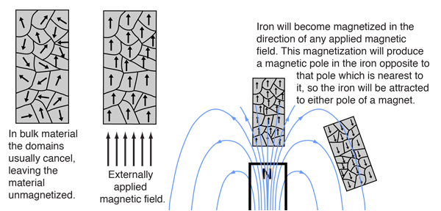
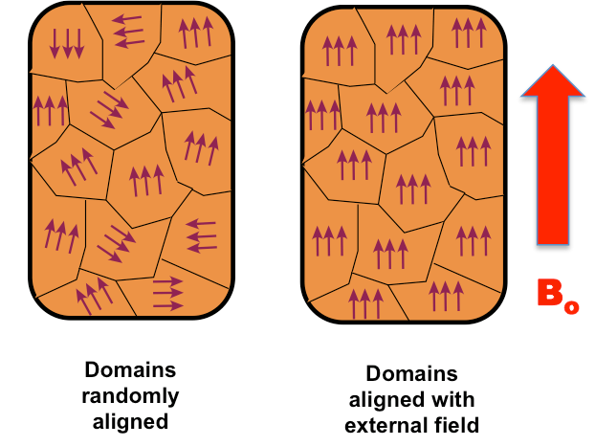
FERROMAGNETISM

Slide 26
Types of Magnetism
Ferromagnetism :
Magnetic moments
are identical
and parallel
+
=
Ferrimagnetism (Néel) :
Magnetic moments
are different
and anti parallel
Antiferromagnetism :
Magnetic moments
are identical
and anti parallel
= 0
+
=
+

Slide 27

Diamagnetic
Feebly repelled by the magnetic fields. Non-metallic elements inert gases and species with paired electrons are diamagnetic
TiO₂, V₂O₅
p⁶

Slide 28
Paramagnetic
Attracted by the magnetic field due to the presence of permanent magnetic dipoles (presence of unpaired electrons).
In magnetic field, these tend to orient themselves parallel to the direction of the field and thus, produce magnetism in the substances.
Should present at least one unpaired electron.
Cu²⁺, Fe³⁺ (d⁵), TiO (d²), CuO (d⁹)

Slide 29
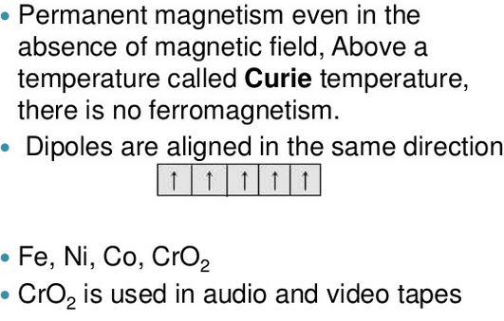
Ferromagnetic

Slide 30
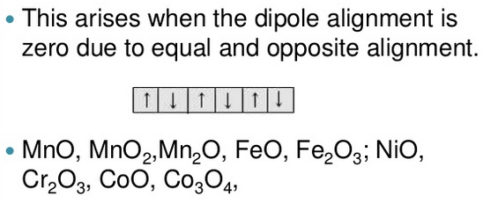
Antiferromagnetic

Slide 31
Magnetic Susceptibility (χ_{m})
It is the property of the substance which shows how easily a substance can be magnetized.
It also related to the force experienced by a substance in a magnetic filed.
The magnetic moment is calculated from the magnetic susceptibility, since the magnetic moment is not measured directly.
The magnetic susceptibility is defied as the ratio of intensity of magnetization (I) in a substance to the applied magnetic field (H) of the substance.
Χ_{m} = I/H
Susceptibility has no unit. But it may be +ve or -ve
When –ve, substance is diamagnetic
When small +ve, substance is paramagnetic.
When large range of +ve, substance is ferromagnetic

Slide 32
Magnetic Susceptibility (χ_{m})
Generally, it is more convenient to use mass unit, therefore, the mass or gram susceptibility is defined as
χ_{g} = χ_{m}/d
Where d is the density of the substance.
The molar susceptibility is the mass susceptibility multiplied by the formula weight
Χ_{m} = χ_{g} x F.W. (F.W. in g/mol

Slide 33
Super-paramagnetism
What is Super-paramagnetism ?
Super-paramagnetism is a form of magnetism which appears in small ferromagnetic or ferrimagnetic nanoparticles.
In case small nanoparticles, magnetization can randomly flip direction under the influence of temperature.
The typical time between two flips is called the Néel relaxation time.
In the absence of an external magnetic field, when the time required to measure the magnetization of the nanoparticles is much longer than the Néel relaxation time, their magnetization appears to be in average zero.
Then, they are said to be in the super-paramagnetic state.
In this state, an external magnetic field is able to magnetize the nanoparticles, similarly to a paramagnet.
However, their magnetic susceptibility is much larger than that of paramagnets.

Slide 34
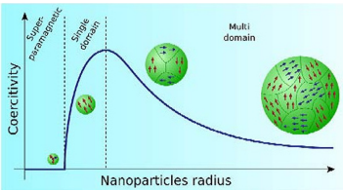
Magnetic Properties of Nanoparticles
The nanometer-sized particles are superparamagnetic, as their property resulting from their tiny size domain i.e., only a few nanometers.
When returned to a zero magnetic field they quickly revert to a non-magnetized state.

Slide 35
Magnetic Properties of Nanoparticles
Magnetic properties of nanoparticles
Magnetic nanoparticles are used for drug delivery, therapeutic treatment, contrast agents for MRI imaging, bioseparation, and in-vitro diagnostics.
These nanometer-sized particles are superparamagnetic, a property resulting from their tiny size—only a few nanometers.
Superparamagnetic nanoparticles are not magnetic when located in a zero magnetic field, but they quickly become magnetized when an external magnetic field is applied.
When returned to a zero magnetic field they quickly revert to a non-magnetized state.
Superparamagnatism is one of the most important properties of nanoparticles used for biomagnetic separation.

Slide 36
Storage or Memory
What is Storage or Memory?
Computer data storage, often called storage or memory, is a technology consisting of computer components and recording media used to retain digital data.
It is a core function and fundamental component of computers.
Why storage is required?
The main memory is temporary memory, the storage is required to store data and programs permanently.
The capacity is limited, the storage is required to store a large amount of data and program.

Slide 37
Storage or Memory
Basic unit of data storage.
Bit: computer works with binary digits. These digits are in the form of 0’s and 1’s. A binary digit is called bit. One bit takes one storage location in memory. It is the smallest unit for data storage.
Byte: A collection of eight bits is called byte. It is used to store single character. The capacity of the memory or the storage is expressed in terms of bytes.
Kilobyte: A kilobyte consists of 1024 bytes. It is denoted by KB.
Megabyte: A megabyte consists of 1024 kilobytes. It is denoted by MB.
Gigabytes: A Gigabyte consists of 1024 MB. It is denoted as GB.
Terabyte: A terabyte consists of 1024 GB. Its is denoted as TB

Slide 38
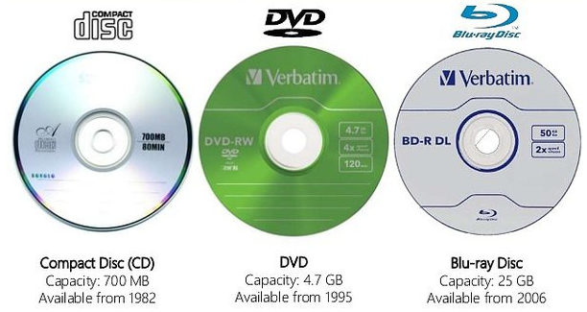
Optical Disc
Optical Disc
Optical disc is a form of removable storage.
It includes CDs, DVDs and blue ray discs, Optical drives use a leaser to read and write data on optical disc.
The leaser stands for Light Amplification through Stimulated Emission of Radiation.
Laser beam writes on the surface by creating small Pit (hole) in the disc. Optical disc commonly store data in a single track.
Optical disc storage capacity is from 700 MB to a several GB. The main categories of optical disc are CD and DVD.

Slide 39
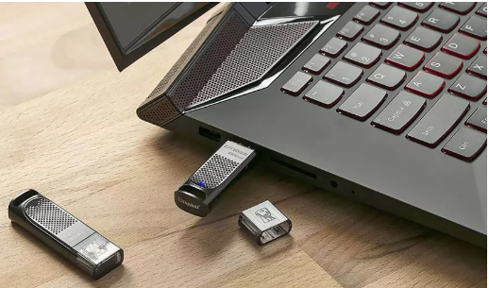
USB Flash Drive
USB flash drive is a flash memory storage drive also are called thumb drives, jump drives, pen drives, tokens, or simply USB drives.
A small, portable flash memory card that plugs into a computer USB port and functions as a portable hard drive.
USB flash drives are touted as being easy-to-use as they are small enough to be carried in a pocket and can plug into any computer with a USB drive.
USB flash drives have less storage capacity than an external hard drive, but they are smaller and more durable because they do not contain any internal moving parts.

